Slide 1
BTP Presentation
Himanshu
18ME10024

Slide 3
Introduction
Dsdas
Sadasdas
Dasdas
Das
d

Slide 4
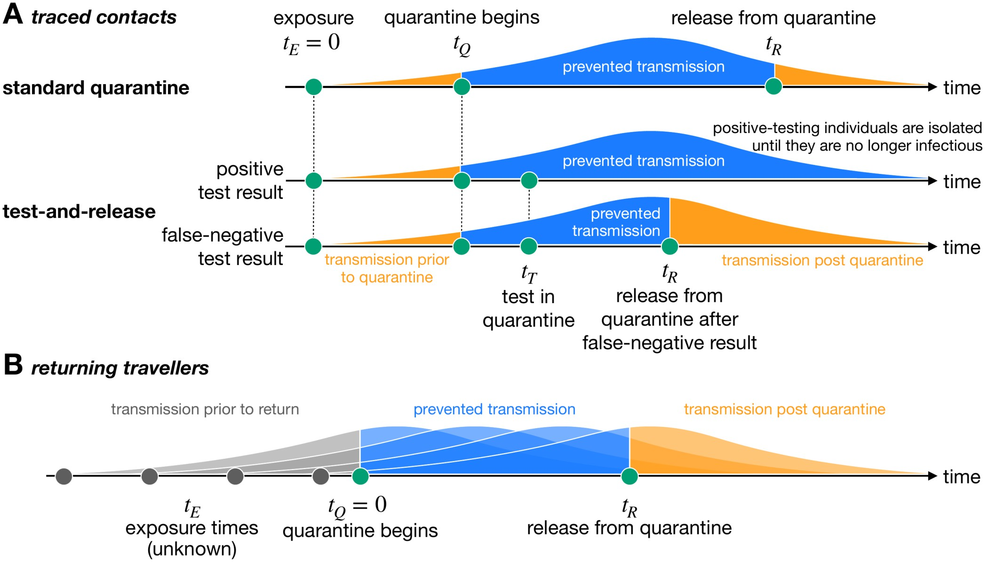
Motivation and Existing Solution
Increased rate of Testing has led to significant prevention in transmission of COVID 19
Frequent Testing can be really affective at catching COVID – 19 infections and potentially blocking transmission
Existing Solution: RTPCR Kits
Takes at least 24 hours to get results
Limited Frequency of tests
Doesn’t account for new strains
Notes:
Researchers have pointed out that pt 1 and 2
The image shown here gives an example of how testing can potentially block transmission even with false negative results:
1.

Slide 5
Problem Statement

